Slide 2
ANRS 170 QUATUOR 4/7 days maintenance strategy in antiretroviral treated adults with HIV-1 infection: an open randomized parallel non-inferiority phase III trial
Oral Abstract n° WEAB0406LB
R. Landman*, P. De Truchis, L. Assoumou, S. Lambert, K. Amat, J. Bellet, B. Lefebvre, C. Allavena, C. Katlama,
Y. Yazdanpanah, J.-M. Molina, A. Gelley, S. Gibowski, J.-C. Alvarez, L. Morand-Joubert, D. Costagliola, P.-M. Girard ANRS 170 QUATUOR study group
* Disclosures : Research grant from Viiv Healthcare, Inc., Gilead Science, Inc., Merck & Co, Inc

Slide 3
QUATUOR – Background
Short-cycle antiretroviral treatment interruption strategy in virologically suppressed patients could improve the convenience, tolerability and cost of ART
5 days on/2 days off (FOTO study¹, Reynolds², Breather - PENTA 16 study³) with EFV-based regimens
4 days on/3 days off: either PI- or NNRTI-based regimens
ICCARRE cohort⁴
ANRS 162-4D trial⁵ pilot study showed a 96% success rate at 48 weeks
The QUATUOR study was designed to demonstrate the non-inferiority of a 4/7 days versus 7/7 days maintenance strategy in patients with controlled viral load (VL) on triple ARV therapy, taking either a PI-, NNRTI- or an INI–based regimen
1 - Cohen CJ, Colson AE, Sheble-Hall AG, et al HIV Clin Trials 2007
2 - Reynolds SJ, Kityo C, Hallahan CW et al. PLoS One 2010
3 - The Breather (PENTA 16) trial group. Lancet HIV 2016.
4 - Leibowitch J, Mathez D, de Truchis P, et al. Faseb J , 2015
5 - De Truchis P, Assoumou L, Landman R et al. J Antimicrob Chemother. 2018

Slide 4
QUATUOR - Study design randomized, multicenter, national, open-label, non-inferiority study in adults with HIV-1 virological suppression
Screening Phase
Controlled Phase
Long-term Follow-up
- VL < 50 c/mL for ≥12 months
- No genotype resistance
- CD4 > 250 cells/mm³
- PI-, NNRTI- ou INI- based regimen with a 2 NRTI backbone
Randomization 1 :1
4D/7 n= 324
4 D/ 7
4 D/ 7
n = 320
4D/7 n= ?????
7 D/ 7
n = 320
Stratified according to the third agent
W0
W48
Primary endpoint
W96
Final endpoint
Planned Sub-studies:
Treatment adherence: self-reported questionnaire and residual plasma concentrations (TDF and third agent); n = 640
Hair, intracellular drugs concentrations (third agent); n = 120
Inflammation and immune activation parameters; n = 120
Total HIV DNA , HIV viral load in semen; n = 120
QOL, self-reported patients satisfaction; n = 640

Slide 5
QUATUOR - Objectives and endpoints
OBJECTIVE: to establish non-inferiority of antiviral activity of 4D/7 versus 7D/7
5% non inferiority margin between groups
PRIMARY ENDPOINT: Proportion of patients with therapeutic success at W48 defined by :
No virological failure (confirmed VL >50 c/mL)
No strategy interruption (except for pregnancy or switching molecules in the same drug class)
SELECTED SECONDARY ENDPOINTS:
Virological failure (VF) at W48
Drug resistance and drug plasma concentration at time of VF
Safety and tolerability
STATISTICAL ANALYSIS
Kaplan-Meier method for primary endpoint, adjusted for third agent class stratification (ITT, PP)
Sensitivity analysis for primary endpoint (Snapshot)
Sub-group analysis for virological failure according to third agent class

Slide 6
QUATUOR - Flow chart
Participants were screened from September 2017 to January 2018
Non-included :
No complete genotype or resistance (n=142)
No virological criteria (n=16)
Others (n=45)
ITT population: randomized patient selection, excluding those who never started study treatment strategy
PP population : excluding discontinuation for other reasons and major deviation from protocol

Slide 7
QUATUOR - Baseline characteristics
Characteristics | 4 D/7 n=318 | 7 D/7 n=318 | Total n=636
Age, year, median (IQR) | 50 (41 – 55) | 49 (41 – 56) | 49 (41 – 55)
Male sex, n (%) | 270 (84.9) | 269 (84.6) | 539 (84.7)
Geographic origin of birth, n (%)
- Europe | 244 (76.7) | 254 (79.9) | 498 (78.3)
- Sub-Saharan Africa | 47 (14.8) | 51 (16.0) | 98 (15.4)
- Other | 27 (8.5) | 13 (4.1) | 40 (6.3)
MSM, n (%) | 211 (66,6) | 215 (67.6) | 426 (67.1)
CD4 nadir (cells/mm³), median (IQR) | 313 (203 – 422) | 289 (189 – 401) | 298 (195 – 412)
CD4 at screening (cells/mm³), median (IQR) | 693 (532 – 898) | 687 (534 – 861) | 689 (533 – 884)
Duration on ARV, year, median (IQR) | 6.5 (3.8 – 12.0) | 7.4 (4.2 – 12.5) | 6.9 (4.0 – 12.4)
Duration of virological suppression (<50 c/mL), year, median (IQR) | 5.1 (3.0 – 8.6) | 6.5 (3.5 – 10.3) | 5.8 (3.3 – 9.6)
Baseline NRTI , n (%)
- TDF-TAF/FTC | 230 (72.3) | 232 (73.0) | 460 (72.6)
- ABC/3TC | 88 (27.7) | 86 (27.0) | 174 (27.4)
Baseline third agent class , n (%)
- INI (DTG/EVG/RAL) | 152 (47.8) (73/65/14) | 152 (47.8) (76/68/8) | 304 (47.8)
- NNRTI (RPV/EFV/ETR) | 148 (46.5) (118/24/6) | 148 (46.5) (110/32/6) | 296 (46.5)
- PI (DRV/ATV/LPV) | 18 (5.7) (16/2/0) | 18 (5.7) (12/4/2) | 36 (5.7)

Slide 8
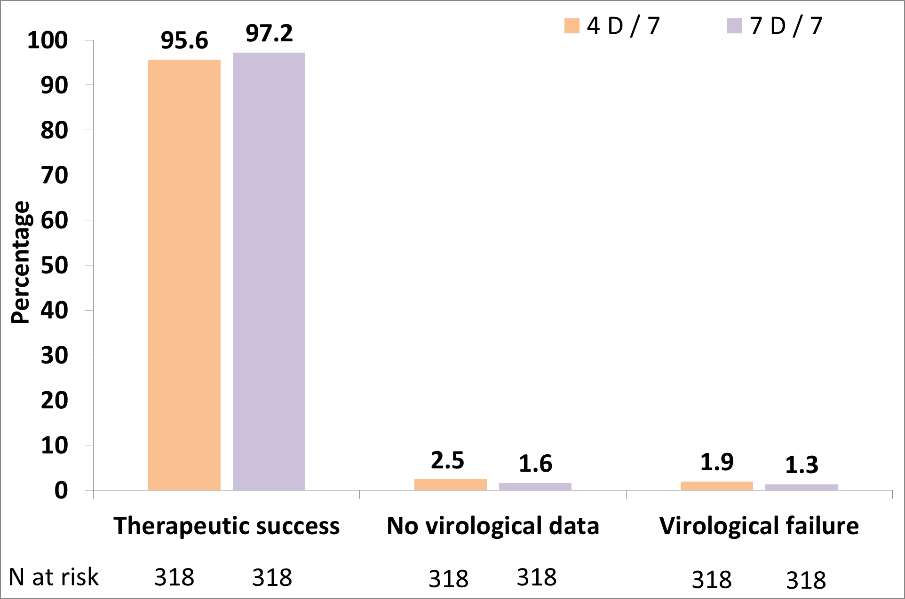
QUATUOR - Primary endpoint at W48 KM estimation (ITT)
Therapeutic success
7 D / 7
4 D / 7
Non inferiority margin
Virological failure
FDA Non- inferiority margin
Treatment differences adjusted by third agent stratification using the Cochran-Mantel-Haenszel method
Difference (95% CI) of proportion

Slide 9
QUATUOR - Virological failure sub-group analysis according to the 3rd agent class
Virological failures
7 D / 7
4 D / 7
 | 7 D / 7 | 4 D / 7
INI (n=304) | n=1 (0.7 %) | n=3 (2.0 %)
NNRTI (n=296) | n=3 (2.1 %) | n=3 (2.0 %)
PI (n=36) | n=0 (0.0 %) | n=0 (0.0 %)
3rd agent
4 D / 7
Difference (95% CI) of proportion
Other sub-group analyses: No statistical difference based on CD4 nadir,
duration of VL <50 c/mL, prior VF, or CD4/CD8 ratio

Slide 10
QUATUOR - Treatment failure at W48
 | 4 D /7 n = 318 | 7 D /7 n = 318
Virological non-response
Confirmed VL > 50c/mL | 6 | 4
No virological failure data
Death | 2* | 0
Discontinuation because of AE | 1** | 0
Lost to follow-up | 0 | 1
Patient decision | 5 | 4
* Cause of death: sudden cardiac death (1), pulmonary cancer (1) ** Discontinuation for AE: depression

Slide 11
QUATUOR - Confirmed virological failures
Arm | ARV regimen | Time of VF | Suspected VF /Confirmed VF (c/mL) | Adequate plasma drug level | RAM* to current treatment in PBMC at baseline | RAM*to current treatment at failure | Susceptibility ** to current treatment at failure | Modification of strategy | Modification of treatment | Virological outcome VL < 50 c/mL at last visit
4 D /7 | TDF+FTC+RPV | W12 | VL=83 VLc=91 | YES | NO | NO | S | YES | NO | YES
 | TDF+FTC+RPV | W12 | VL=713 VLc=69700 | YES | NO | RT:M184I, E138K, Y188L | R to 3TC/FTC, RPV | YES | YES | YES
 | TAF+FTC+EVG/c | W24 | VL=736 VLc=1710 | YES | NO | NO | S | YES | YES | YES
 | TAF+FTC+EVG/c | W36 | VL=393 VLc=241 | NO | NO | NO | S | YES | YES | YES
 | TDF+FTC+RPV | W36 | VL=69 VLc=129 | NOT DONE | NO | RT: M184V, E138K, V179I, H221Y | R to 3TC/FTC, RPV | YES | YES | YES
 | ABC+3TC+RAL | W48 | VL=331 VLc=230 | YES | NO | RT: M184I; INT: N155H | R to ABC, 3TC/FTC, RAL | YES | YES | YES
7 D/7 | TDF+FTC+RPV | W36 | VL=60 VLc=229 | YES | NO | NO | NAmp | NR | NO | YES
 | ABC+3TC+DTG | W48 | VL=432 VLc=372 | YES | NO (INT NAmp) | NO | S | NR | NO | YES
 | TDF+FTC+RPV | W48 | VL=1502 VLc=963 | NO | NO | NO | S | NR | YES | YES
 | ABC+3TC+RPV | W48 | VL=62 VLc=105 | YES | NO | RT: K101E/K | R to RPV | NR | YES | NO (52 c/mL)
* Sanger sequencing
* * resistance associated mutations According to ANRS algorithm - http://www.hivfrenchresistance.org/index.html
S : susceptibility
R : resistance
NAmp : not amplified
NR : not relevant

Slide 12
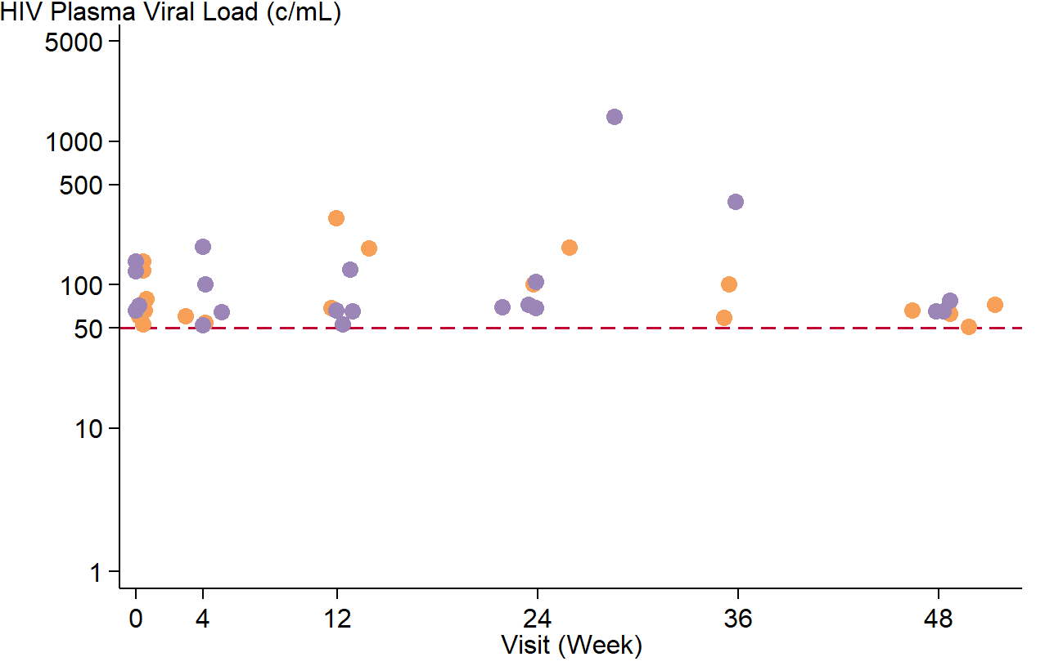
QUATUOR - Occurrence of viral blips
 | W0 | After W0
4 D/ 7 | 6 | 13
7 D/ 7 | 4 | 17
No statistical difference
between 4D /7 and 7D /7

Slide 13
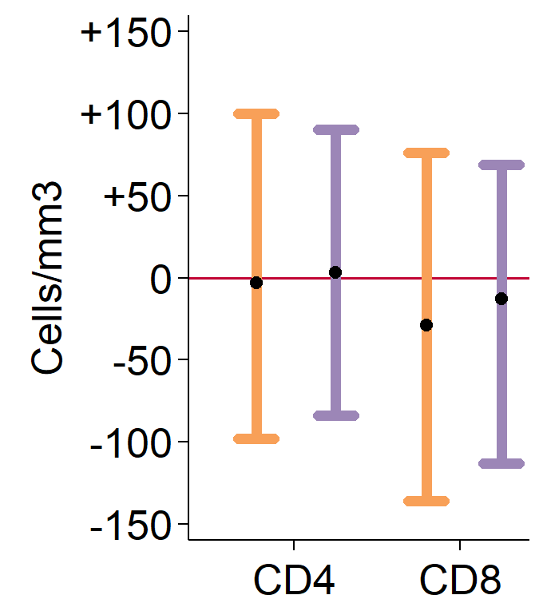
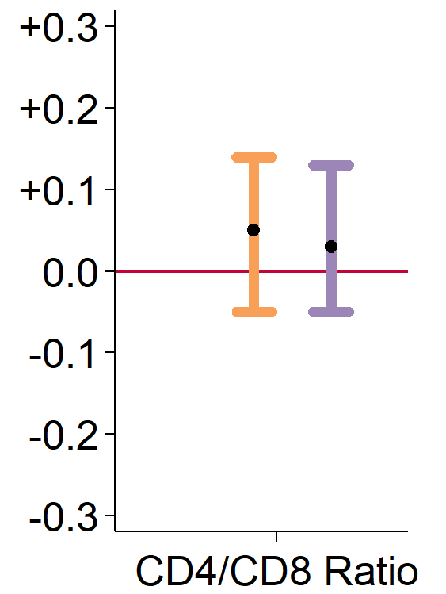
QUATUOR - Median changes between baseline and W48
Delta W48-baseline
*
Delta W48-baseline
*p-value<0.05

Slide 14
QUATUOR - Adverse events
 | 4D / 7 n=318 | 7D / 7 n=318 | P-value
All adverse events (%) | 72.3% | 73.9% | 0.721
AE grade 3/4* (%) | 7.9% | 9.4% | 0.594
Death (n) | 2 : 1 sudden cardiac arrest 1 pulm. adenocarcinoma | 0 | 0.499
Discontinuation due to AE (n) | 1: depression | 0 | 1.000

Slide 15
QUATUOR : Conclusions
The ANRS 170 QUATUOR randomized trial demonstrates the non-inferiority of a 4/7 days versus 7/7 days maintenance strategy whatever the 3rd agent class.
No tolerance-related issues.
Ongoing analysis: long-term W96 follow-up / plasma, intracellular, and hair PK analysis / inflammatory markers / viral load in semen/ residual viremia / HIV total DNA.
Results show a new robust maintenance therapy option
This strategy leads to a direct cost reduction of 43% in high-income countries, and could allow more patients to access care in low-income countries

Slide 16
ANRS 170 QUATUOR - Acknowledgments
We thank everyone who contributed to the success of this trial :
All study participants
The QUATUOR clinical investigators and their staff in France
PI : Dr. Roland Landman and Dr. Pierre de Truchis
Sponsor : ANRS-Inserm – Pr.François Dabis, Ventzislava Petrov-Sanchez, Ambre Gelley, Séverine Gibowski, Guillaume Le Meut
Statistics : Lambert Assoumou, Jonathan Bellet, Dominique Costagliola
Investigators :
I. Lamaury, F. Bani-Sadr, , G. Force, A. Chabrol, P. Genet, O. Patey, C. Drobacheff-Thiebaut- C. Chirouze, ,A. Fresard, C. Duvivier, V. Tolsma, N. Lerolle, A. Rami, G. Pichancourt, P. de Truchis, J. Bottero, G. Pialoux, O. Bouchaud, S. Abgrall, L. Weiss, D. Salmon-Céron, D. Zucman, J.D Lelièvre, C. Katlama, A. Simon, P.M. Girard, J.M. Molina, A. Cabié, P. Morlat, D. Neau, C. Genet, D. Makhloufi, I. Poizot-Martin, R. Landman, J. Reynes, F. Raffi, O. Bollengier-Stragier , A. Naqvi, E. Rosenthal, C. Arvieux, R. Buzelé, M.L. Batard, L. Bernard, P. Delobel, R. Verdon, L. Piroth, P. Leclercq, F. Ajana, M. André, P. Miailhes, A. Greder, B. Elharrar, M.A. Khuong, L. Blum,P. Philibert, L. Slama, H. Hitoto, I. Darasteanu
Coordination and monitoring IMEA: Karine Amat, Aïda Benalycherif, Babacar Sylla
Virology coordination : Pr. Laurence Morand-Joubert, Dr. Sidonie Lambert
Pharmacology coordination : Pr. Jean-Claude Alvarez, Dr. Emuri Abe
Immunology coordination: Pr. Jacqueline Capeau
DSMB: Pr. Rodolphe Thiebaut, Pr Nathan Clumeck, Dr. Francesca Ceccherini-Silberstein , Dr. Laurent Decosterd, Vincent Leclercq
President scientific committee : Pr Pierre Marie Girard
TRT-5 patients association: Vincent Leclerc, Marek Korzec
ICARRE association, Dr.Jacques Leibowitch

